Slide 1
Management of premalignant and malignant tumors of the skin
Dr. S. Kumarage
Senior lecturer/Consultant Surgeon
Faculty of Medicine
University of Kelaniya
25th Original

Slide 2
Tumours of the skin
Epidermal
Dermal
Dermoepidermal
Melanocytic
Epidermal appendage tumours

Slide 3
Epidermal skin tumours
Cell of origin | Benign tumour | Malignant tumour
Basal cell | Seborrheic keratosis | Basal cell carcinoma
Keratinocytes | Squamous papilloma * | Squamous carcinoma
Melanocytes | Naevus | Malignant melanoma
Merkel cells |  | Merkel cell carcinoma

Slide 4
Solar keratosis
Common premaliganant condition of the epidermis
Occurs in sun exposed skin
Typically multiple
Most common in fair skin people
Treatment modalities
Sun protection
Liquid Nitrogen- Cryo therapy
Curretage
Topical chemotherapy- 5 FU
Surgical excision

Slide 5
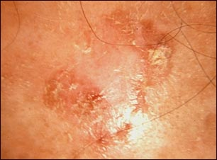

Slide 6
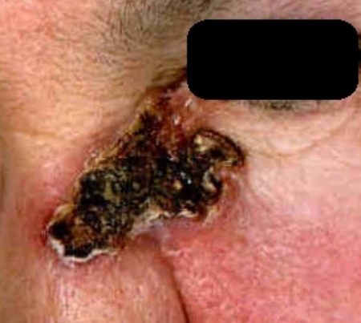
Basal cell carcinoma

Slide 7
They are the commonest skin cancer and the most frequent malignancy in Caucasians
rare in dark skinned races
highest incidence is found in populations exposed to high levels of ultraviolet light (e.g. Australia)
Despite the high incidence of these tumours the mortality is low
80% occur on the face above an imaginary line from the mouth to the ear.
Less than 1 in 200 BCCs metastasize.

Slide 8
Predisposing factors include albinism, xeroderma pigmentosa, ultraviolet light and arsenic toxicity.
Several treatment options exist. These include:
Primary resection +/- closure with a graft or rotational flap
Radiotherapy
Over 95% are cured by adequate surgery.

Slide 9
Squamous cell carcinoma
Sun exposed skin of elderly fair skinned people
Second common malignant neoplasm of the skin
Locally aggressive tumour
Metastases rare - < 1%
Also in relation to
Burns scars
Marjolin’s ulcer
Chronic ulcers
Infected sinuses
HPV
Irradiation

Slide 10
Clinical presentations
Nodule
Plaque
Ulcer

Slide 11
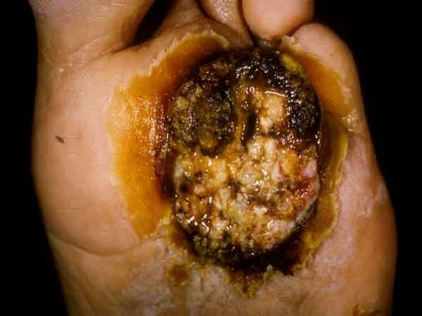

Slide 12
Treatments
Complete excision
Radiotherapy

Slide 13
Cutaneous metastasis
Occurs in 5% of patient with internal malignancy
Carcinoma of the breast/lung
May be solitary or multiple intradermal nodule
Sister Joseph’s nodule- GI malignancy

Slide 14
Melanocytic lesions
Benign Naevi
Epidermal
Intra dermal
Junctional
Compound
Special types
Malignant Melanomas
Superficial spreading melanoma (65%)
Nodular melanoma (27%)
Lentigo maligna melanoma (7%)
Acral lentiginous melanoma (1%)

Slide 15
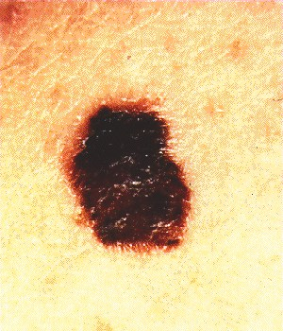
Melanocytic lesions

Slide 16
Malignant melanoma
Invasive malignant melanoma arise
De novo
From – superficial spreading, lentigo maligna or a congenital giant cell naevus
Occurs most often in the skin
Also in the oral cavity and nasal mucosa
Choroid layer in the eye
GIT – oesophagus and anus
Bronchus
Vagina

Slide 17
Malignant melanoma
Clinically
Elevated pigmented nodule
Grows rapidly
Tends to bleed and ulcerate
Metastases occurs early via the blood stream and lymphatics

Slide 18
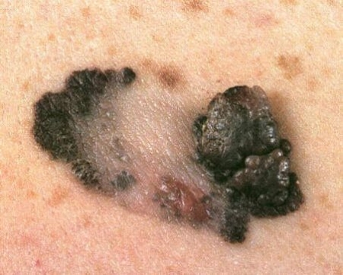

Slide 19
Superficial spreading melanomas usually occur in middle age and are commonly seen on sun exposed skin - the lower legs of women and the trunk of men
Nodular melanomas are aggressive tumours and occur in a slightly younger age group
Lentigo Maligna is the least aggressive form of melanoma
Acral lentiginous melanoma is the most frequent type seen in Negroes occurring on the palms of the hand and soles of the feet. Subungual melanomas are included in this group.

Slide 20
Tumour thickness is the most important prognostic factor for local and distant recurrence and overall survival in melanoma
Tumour thickness is commonly assessed by the Breslow thickness which is the distance in millimeters from the top of the granular layer of the epidermis to the deepest part of the tumours.
The five year survival for tumours
<0.75 mm is 95-99%
0.76-1.49 mm is 80-90%
1.5-3.99 mm is 60-75%
>4.0 mm is <50%.

Slide 21
The management of the regional nodes in malignant melanoma is controversial.
20% of clinically palpable nodes are histologically negative.
20% palpably normal nodes have occult metastases

Slide 22
Prognostic features
Type of melanoma
Depth of invasion
Level of invasion
Clinical stage

Slide 23
Therapeutic lymph node dissection provides regional control and prognostic information but does not improve survival
<0.75 mm as 90% will be cured by local surgery alone
For patients with tumours >4.0 mm 70% will have distant metastases at presentation and lymphadenectomy provides no survival advantage

Slide 24
Management
Surgical excision
In clinical practice was suggested by Neades et al (1993) who recommended that impalpable lesions be excised with a margin of 1 cm, palpable lesions 2 cms and frankly nodular lesion 3 cms.
Lymph node dissection
Adjuvant chemotherapy
Isolated lymph perfusion

Slide 25
Thank you

